Slide 1
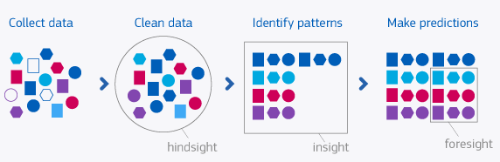
Predictive analytics with ensemble learning
Chapter 03
Artificial Intelligence with python

Slide 2
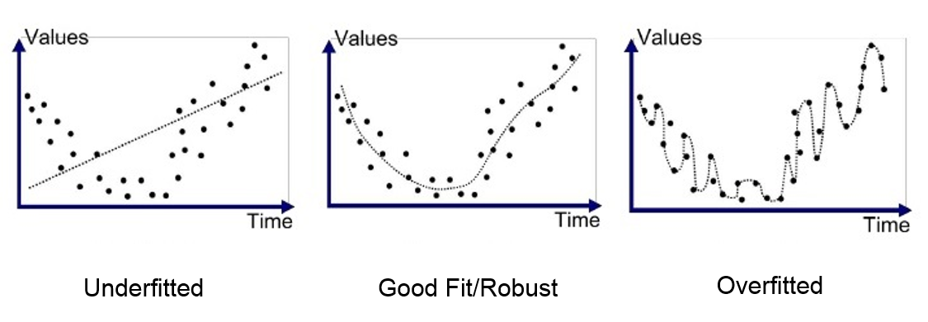
Model training and error
Overfitting
Overfitting is an error that occurs in data modeling as a result of a particular function aligning too closely to a minimal set of data points.
A overfitted model may be too complicated, making it ineffective.
An overfit model has low bias and high variance
Underfitting
it is too simple, with too few features and too little data to build an effective model
an underfit model has high bias and low variance.

Slide 3
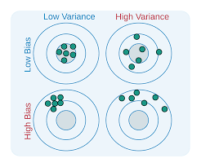
Variance vs bias

Slide 4
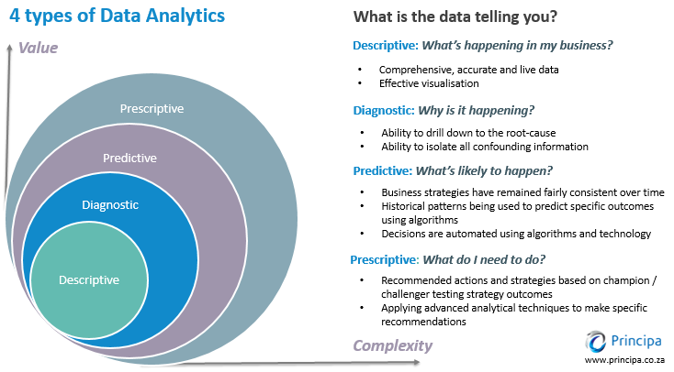
Types of analytics

Slide 5
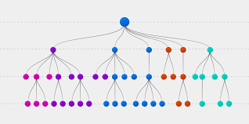
Decision trees (DT)
A Decision Tree is a structure that allows us to split the dataset into branches and then make simple decisions at each level.
This will allow us to arrive at the final decision by walking down the tree.
Decision Trees are produced by training algorithms, which identify how we can split the data in the best possible way
Any decision process starts at the root node at the top of the tree.
Each node in the tree is basically a decision rule.
Algorithms construct these rules based on the relationship between the input data and the target labels in the training data.
The values in the input data are utilized to estimate the value for the output.

Slide 6
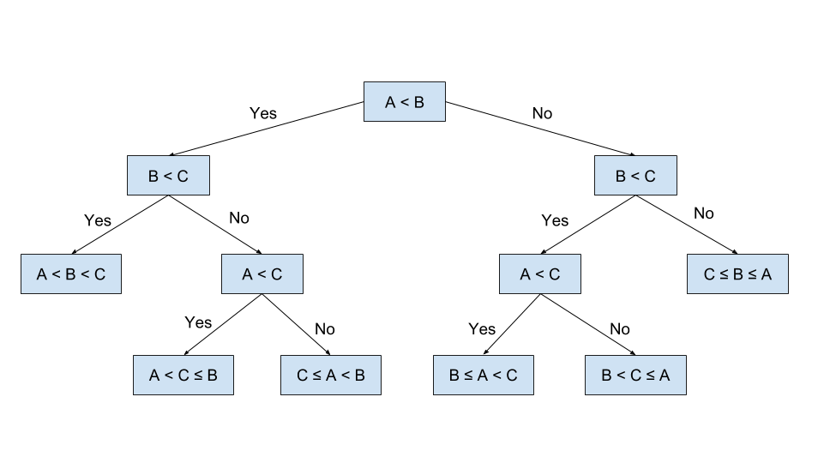
Decision tree

Slide 7
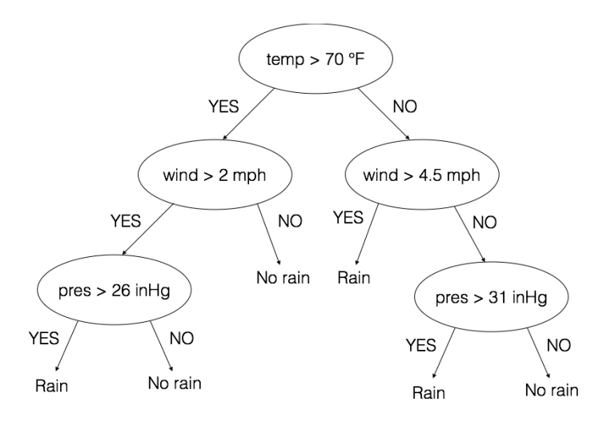
Decision tree

Slide 8
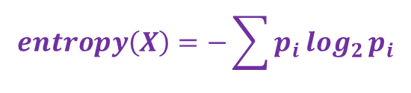
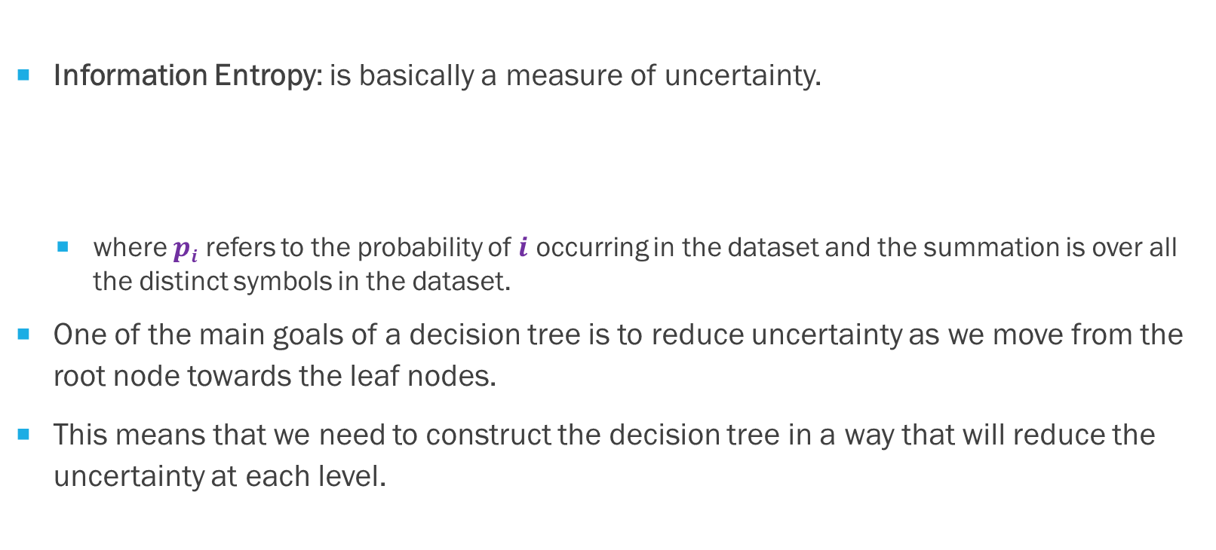
Building decision tree
Information Entropy: is basically a measure of uncertainty.
where $pi$ refers to the probability of $i$ occurring in the dataset and the summation is over all the distinct symbols in the dataset.
One of the main goals of a decision tree is to reduce uncertainty as we move from the root node towards the leaf nodes.
This means that we need to construct the decision tree in a way that will reduce the uncertainty at each level.
$$entropy\left(X\right)=−\sum{p_{i}\log_{2}{p_{i}}}$$

Slide 9
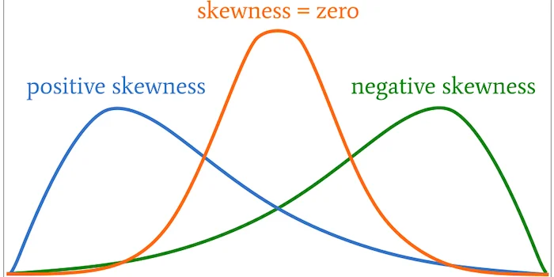
Building dt
Let a dataset consisting of 60 items. There are 3 types of items.
Now if each item appears 20 times in this dataset, the entropy is high because there is a lot of uncertainty. As in, if you randomly pick an item, there is an equal chance of getting any of the three items.
On the other hand, if the first item appears 58 times and the remaining two items appear 1 time each, then the uncertainty is really low. If you randomly pick a sample, you can say with some certainty that it’s going to be the first item.
So in order to reduce the entropy, we need the dataset to be skewed in some way.

Slide 10
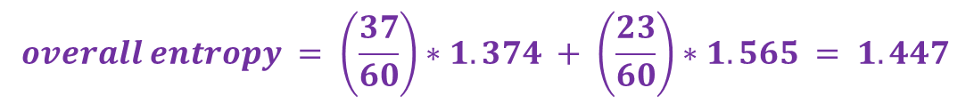
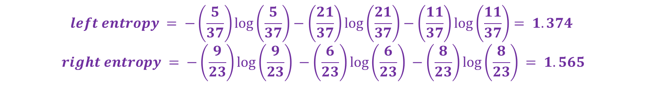
reduce the entropy in the decision tree
Let 1st item appears 14 times, the 2nd item appears 27 times, and 3rd item appears 19 times.
The entropy is:
To reduce the overall entropy split the dataset into two parts. Here are the splits:
New entropies are
$$entropy = − \left(\frac{14}{60}\right)∗log\left(\frac{14}{60}\right) − \left(\frac{27}{60}\right)∗log\left(\frac{27}{60}\right) −\left(\frac{19}{60}\right)log\left(\frac{19}{60}\right) = 1.537$$
$$left subtree = \left[5, 21, 11\right] right subtree = [9, 6, 8]$$
$$left entropy = −\left(\frac{5}{37}\right)\log\left(\frac{5}{37}\right)−\left(\frac{21}{37}\right)\log\left(\frac{21}{37}\right)−\left(\frac{11}{37}\right)\log\left(\frac{11}{37}\right)= 1.374$$
$$right entropy = −\left(\frac{9}{23}\right)\log\left(\frac{9}{23}\right) −\left(\frac{6}{23}\right)\log\left(\frac{6}{23}\right) −\left(\frac{8}{23}\right)\log\left(\frac{8}{23}\right) = 1.565$$
$$overall entropy = \left(\frac{37}{60}\right)∗1.374 + \left(\frac{23}{60}\right)∗1.565 = 1.447$$
$$information gain =initial entropy−new entropy= 1.537 − 1.447 = 0.09$$

Slide 11
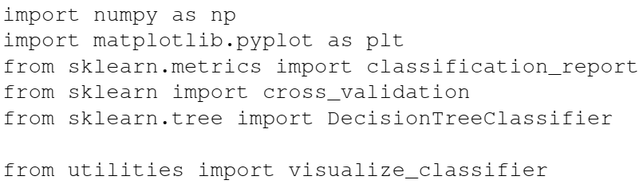
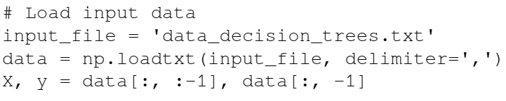
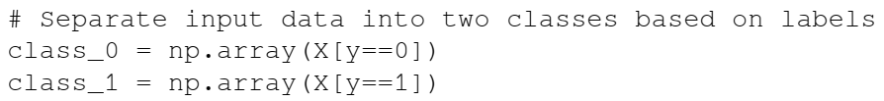
Decision tree classifier

Slide 12
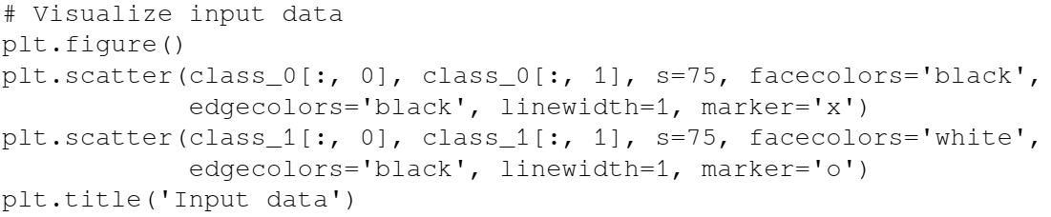
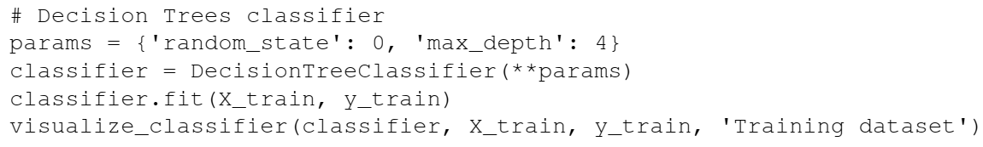

Slide 13
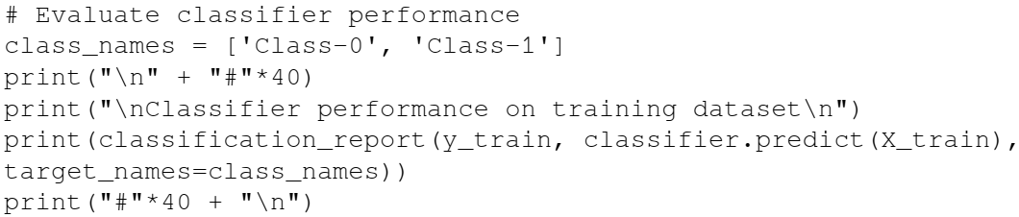
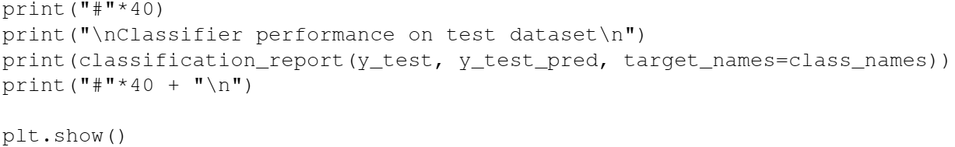
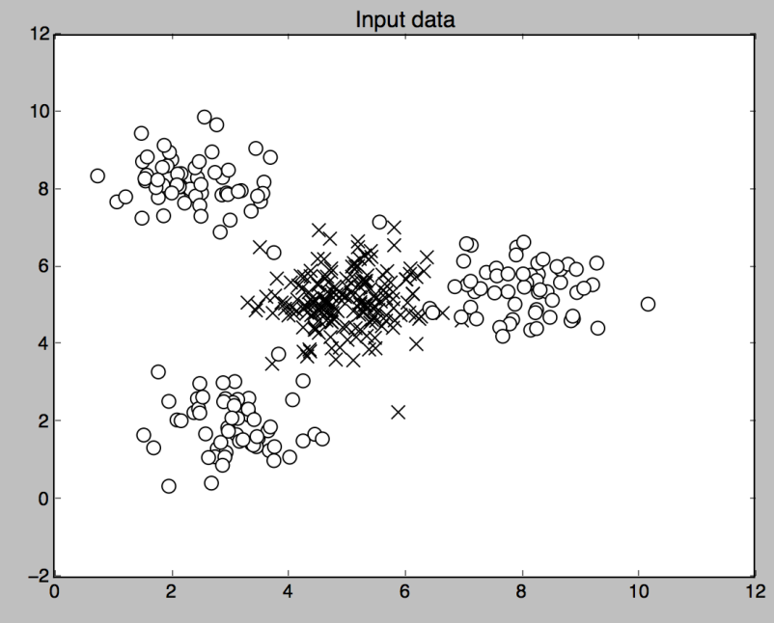
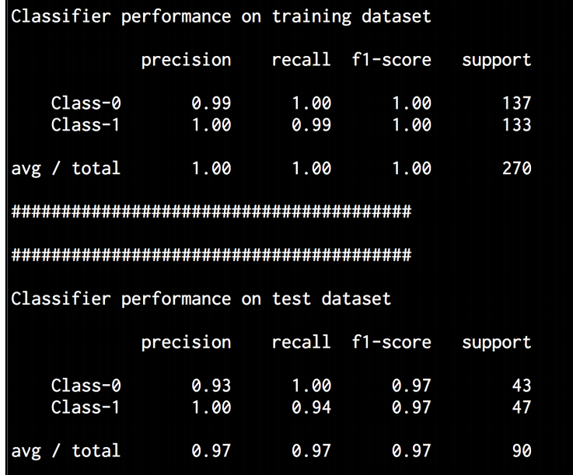

Slide 14
Ensemble Learning
The process of building multiple models and then combining them in a way that can produce better results than individual models.
These individual models can be classifiers, regressors, or anything else that models data in some way
Ensemble learning is used extensively across multiple fields
To minimize the possibility of a wrong or suboptimal decision

Slide 15
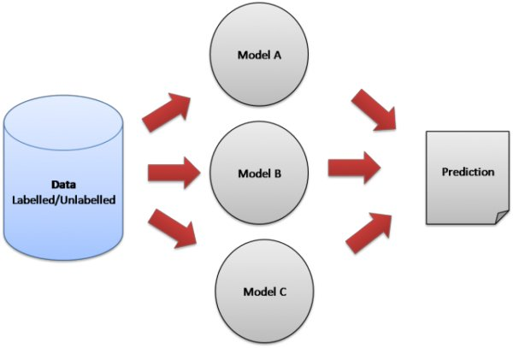

Slide 16
Building ensemble models
Most commonly used procedure to select a model is to choose the one with the smallest error on the training dataset.
The problem with this approach is that it will not always work
The model might get biased or overfit the training data
The diversity is achieved by using different training parameters for each individual model
This means that each model will use different rules to make an inference, which is a powerful way of validating the final result
If there is agreement among the models, then we know that the output is correct

Slide 17
Random Forests and Extremely Random Forests
Ensemble learning where individual models are constructed using Decision Trees
This ensemble of Decision Trees is then used to predict the output value
We use a random subset of training data to construct each Decision Tree
This will ensure diversity among various decision trees
Random Forests do not overfit.
A diverse set of Decision Trees using various random subsets, model overfitting is avoided in training
The nodes are split successively and the best thresholds are chosen to reduce the entropy at each level
This split doesn't consider all the features in the input dataset. It chooses the best split among the random subset of the features
This randomness tends to increase the bias of the random forest, but the variance decreases because of averaging.
Hence, we end up with a robust model

Slide 18
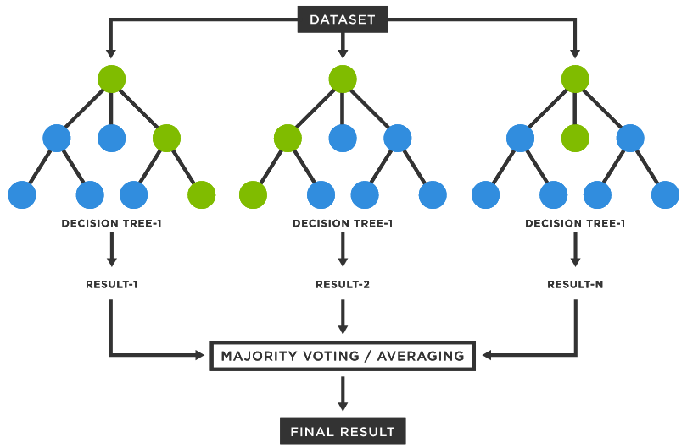

Slide 19
Extremely Random Forests
Extremely Random Forests take randomness to the next level.
Along with taking a random subset of features, the thresholds are chosen at random too.
These randomly generated thresholds are chosen as the splitting rules, which reduce the variance of the model even further.
Hence the decision boundaries obtained using Extremely Random Forests tend to be smoother than the ones obtained using Random Forests

Slide 20
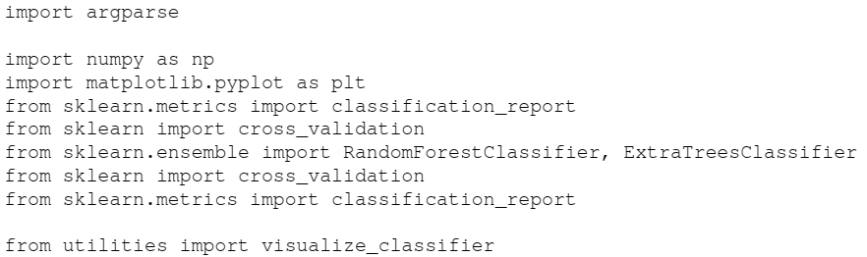
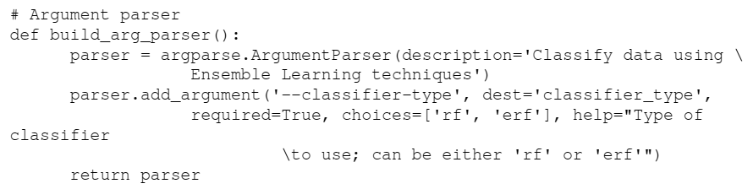
Building Random Forest classifiers

Slide 21
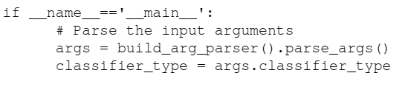
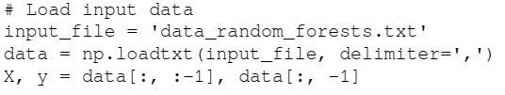
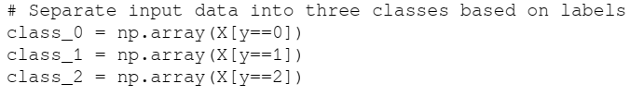
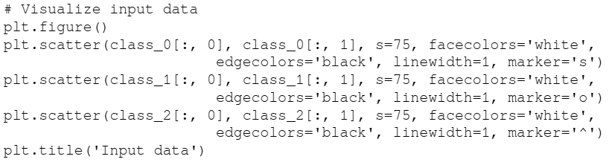

Slide 22
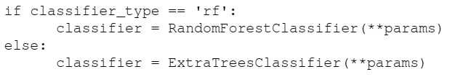

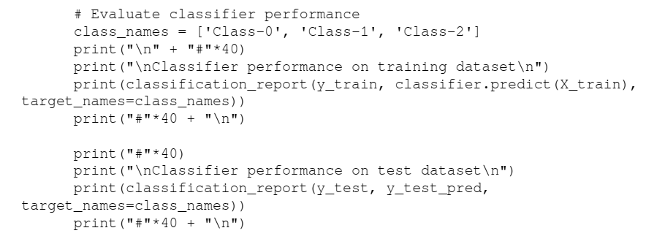
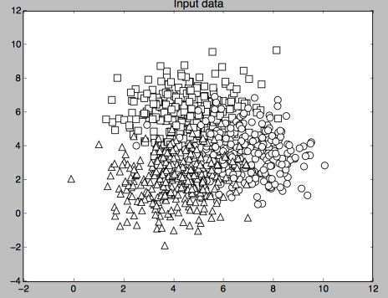

Slide 23
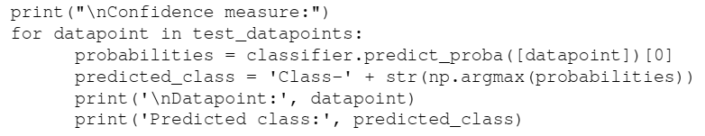
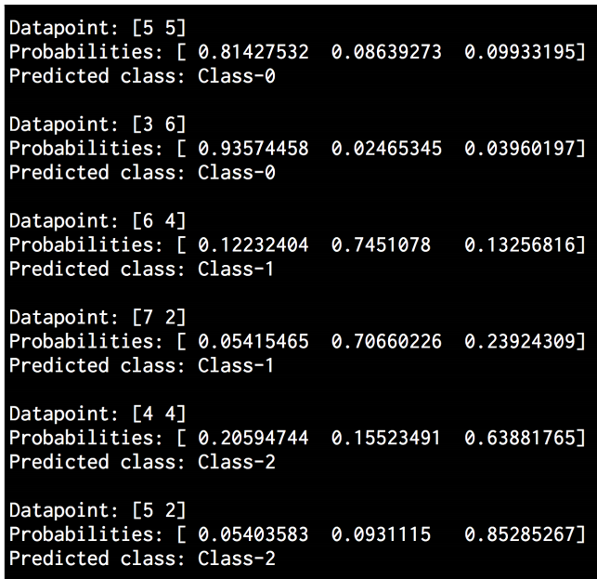
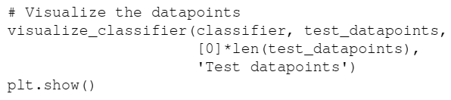

Slide 24
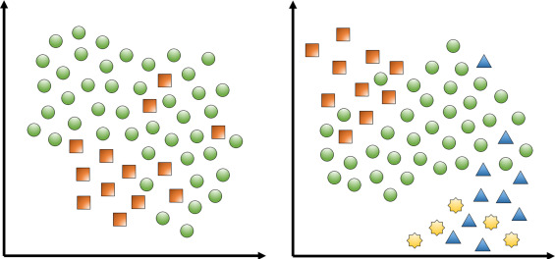
Dealing with class imbalance
A classifier is only as good as the data that's used for training
For a classifier to perform well, it needs to see equal number of points for each class
But when we collect data in the real world, it's not always possible to ensure that each class has the exact same number of data points
If one class has 10 times the number of data points of the other class, then the classifier tends to get biased towards the first class.
Hence we need to make sure that we account for this imbalance algorithmically

Slide 25
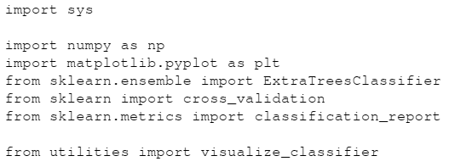


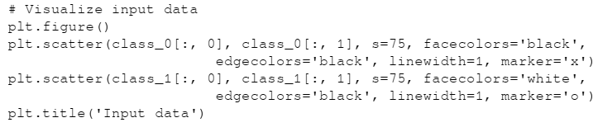

Slide 26
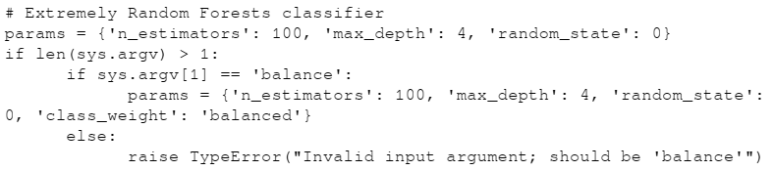

Slide 27
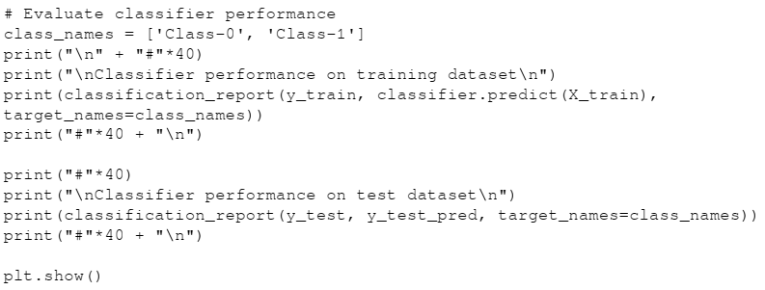
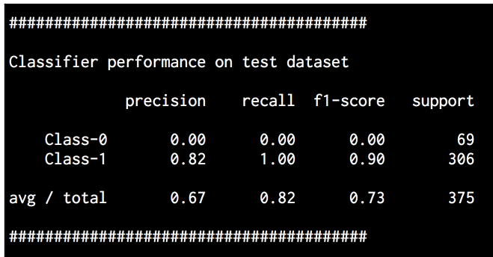

Slide 28
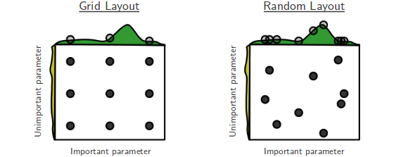
Finding optimal training parameters using grid search
Grid search allows us to specify a range of values and the classifier will automatically run various configurations to figure out the best combination of parameters.

Slide 29
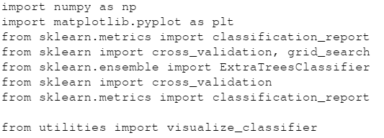



Slide 30
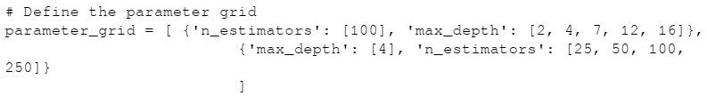
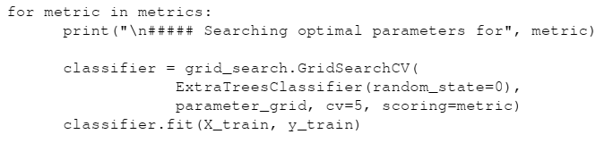
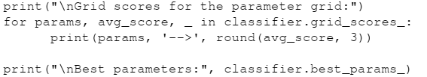


Slide 31
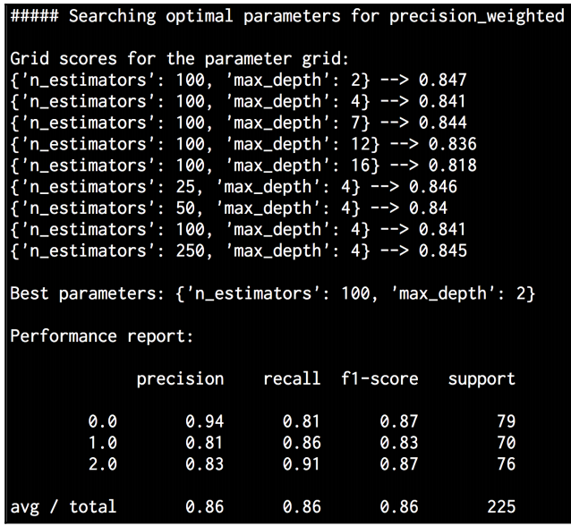
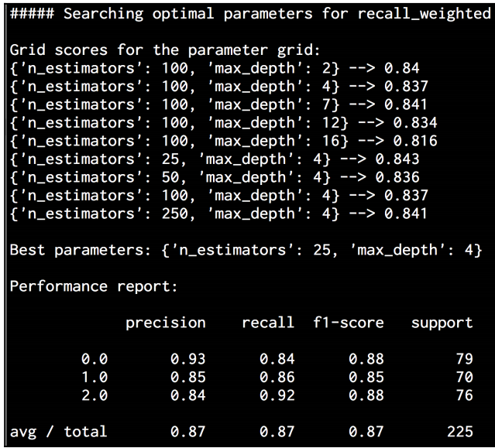

Slide 32
A dataset that contains N-dimensional data points, not all features are equally important and some are more discriminative than others
If we have this information, we can use it to reduce the dimensional.
Low value and redundant features can be removed,
This is very useful in reducing the complexity and increasing the speed of the algorithm

Slide 33
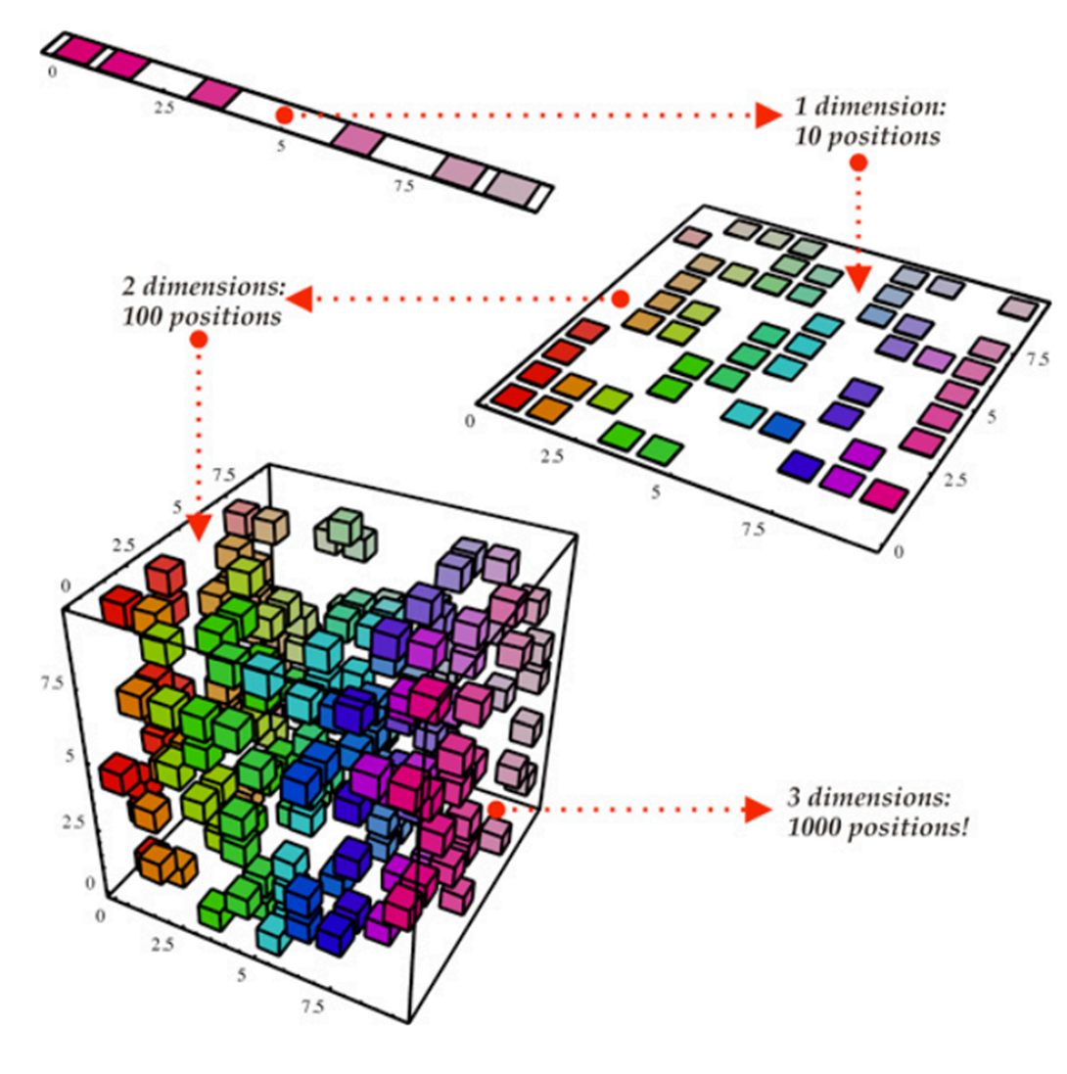
Dimensionality reduction

Slide 34
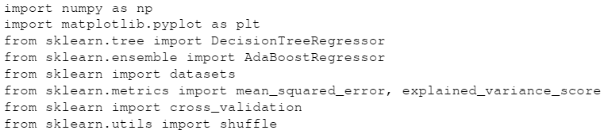



Slide 35





Slide 36



Slide 37
Predicting traffic using Extremely Random Forest regressor

